Slide 1
You are free to structure your presentations to your liking, but students tend to have success with the following format.
Title Slide
Include the name of the Project and Group Members
Motivation & Summary Slide
Define the core message or hypothesis of your project.
Describe the questions you asked, and why you asked them
Describe whether you were able to answer these questions to your satisfaction, and briefly summarize your findings
Questions & Data
Elaborate on the questions you asked, describing what kinds of data you needed to answer them, and where you found it
Data Cleanup & Exploration
Describe the exploration and cleanup process
Discuss insights you had while exploring the data that you didn't anticipate
Discuss any problems that arose after exploring the data, and how you resolved them
Present and discuss interesting figures developed during exploration, ideally with the help of Jupyter Notebook
Data Analysis
Discuss the steps you took to analyze the data and answer each question you asked in your proposal
Present and discuss interesting figures developed during analysis, ideally with the help of Jupyter Notebook
Discussion
Discuss your findings. Did you find what you expected to find? If not, why not? What inferences or general conclusions can you draw from your analysis?
Post Mortem
Discuss any difficulties that arose, and how you dealt with them
Discuss any additional questions that came up, but which you didn't have time to answer: What would you research next, if you had two more weeks?
Questions
Open-floor Q&A with the audience

Slide 2


Slide 3
Correlation of Obesity and Food Options by City Population
Team Members: Liliana Ilut, Vasil Nenov, Quentin Sloboda

Slide 4
Define the core message or hypothesis of your project.
Exploring if there is a correlation between number and restaurants and obesity rate in the top 300 counties by population.
Describe the questions you asked, and why you asked them
1st question: Can the amount of restaurants in a city be a predictor of a city's economic standing?
2nd question: Does a city with a higher economic standing have a lower obesity rate?
3rd question: Is there a particular correlation between restaurants and obesity?
4th question: Is there a correlation between Population and Restaurant Number?
Describe whether you were able to answer these questions to your satisfaction, and briefly summarize your findings
We believe we answered the questions to our own satisfaction, however our findings show little to no correlation between our 4 datasets. We looked at the obesity rate by county, the number of restaurant in each county, and the median income for each county. We then compared those datasets to the 300 top populated counties.

Slide 5
Elaborate on questions
1st question: Can the amount of restaurants in a city be a predictor of a city's economic standing?
#2nd question: Does a city with a higher economic standing have a lower obesity rate?
#3rd question: Is there a particular correlation between restaurants and obesity?
#4th question: Is there a correlation between Population and Restaurant Number?
Data Sets Used and where to find them
Top 300 U.S. Counties by Population https://www2.census.gov/programs-surveys/popest/datasets/2010-2019/
Household Income https://data.census.gov/cedsci/
Obesity Percentage https://data.census.gov/cedsci/
Number of Restaurants https://www.naics.com/search/

Slide 6
Data Cleanup & Exploration
Describe the exploration and cleanup process
Data.census.gov allows chart that one can manipulate to get perfect datasets to use.
Population we combined county and state into one column.
Obesity we combined county and state into one column.
Income we only kept Location, Household Total, Median and Mean income.
Restaurant we only kept Location, NAICS Code, NAICS Description, Total CBP and NES Establishments, CBP Establishments Percentage, NES Establishments Percentage, CBP Establishments.
Discuss insights you had while exploring the data that you didn't anticipate
Discuss any problems that arose after exploring the data, and how you resolved them
Present and discuss interesting figures developed during exploration, ideally with the help of Jupyter Notebook

Slide 7
Data Analysis
Discuss the steps you took to analyze the data and answer each question you asked in your proposal
Present and discuss interesting figures developed during analysis, ideally with the help of Jupyter Notebook

Slide 8
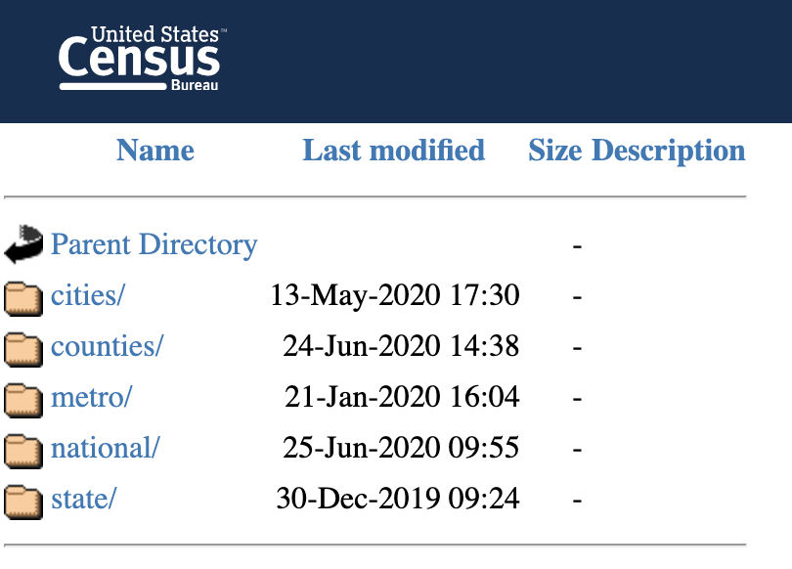
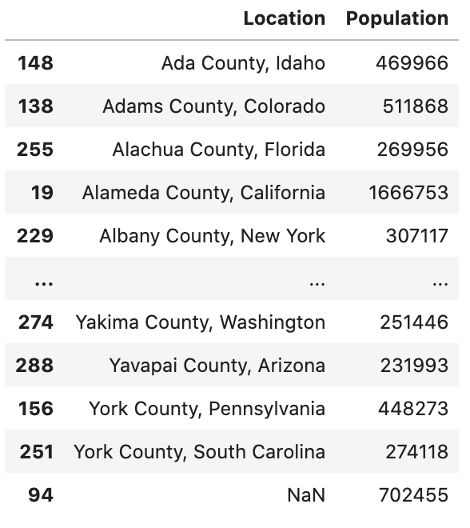
Top 300 Counties by Population

Slide 9
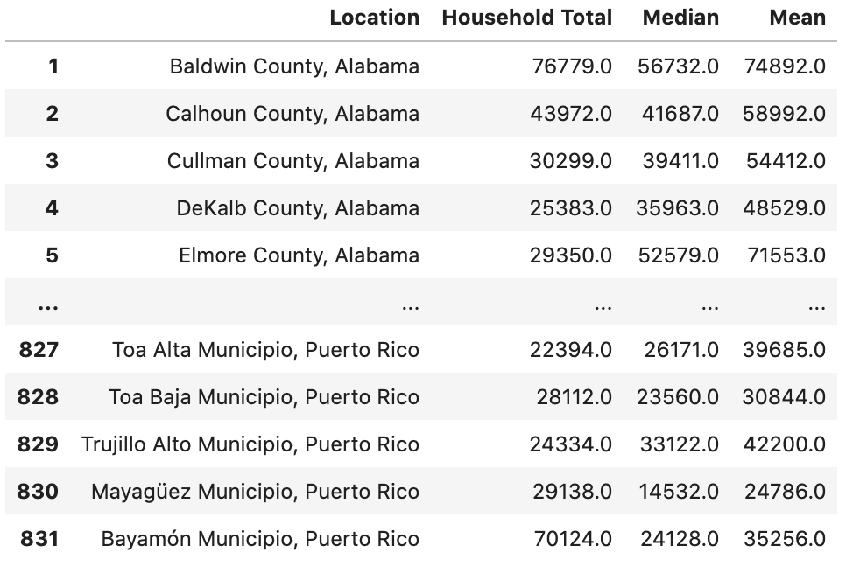
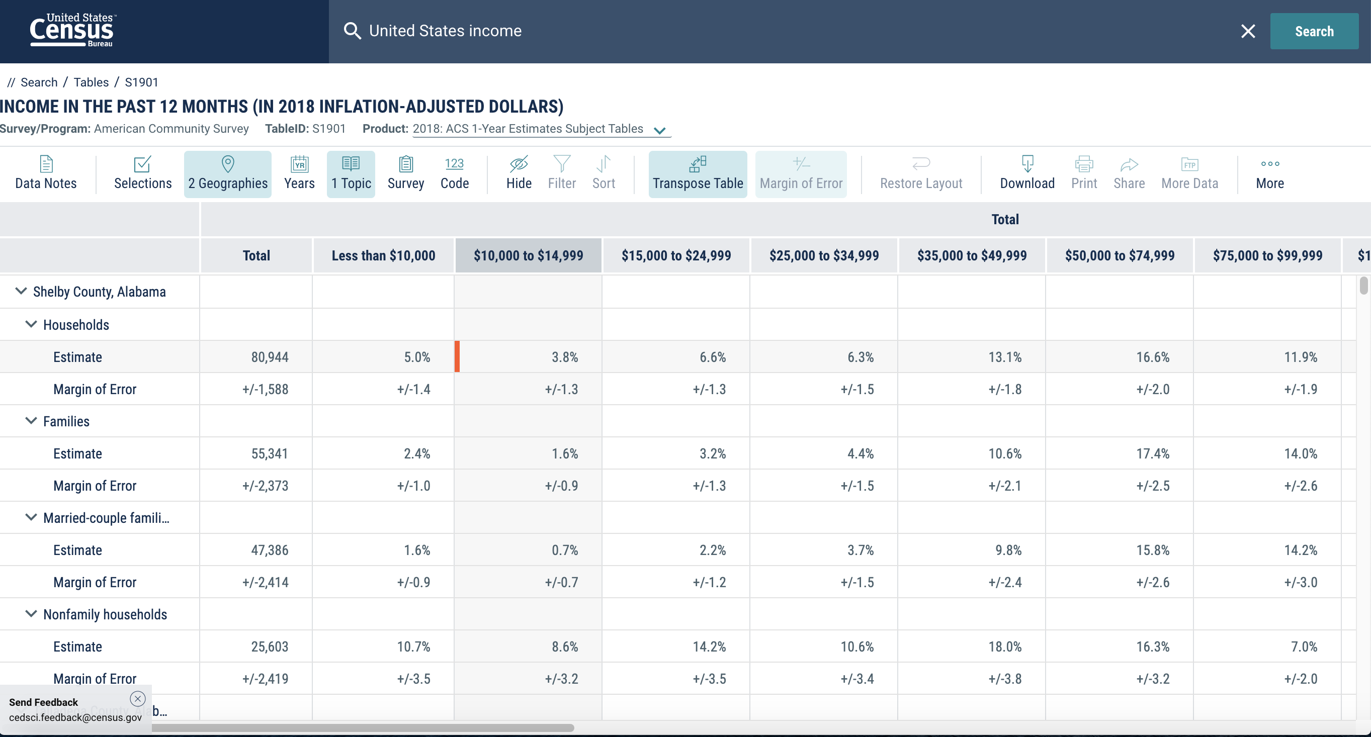
Household Income by County

Slide 10

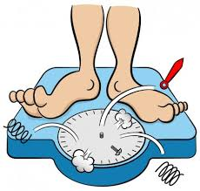
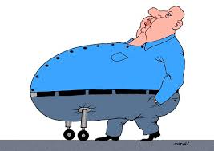
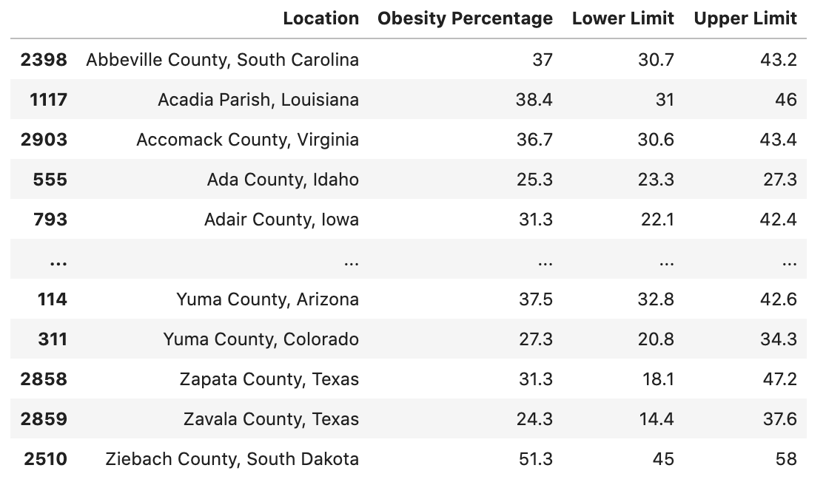

Obesity Percentage by County

Slide 11
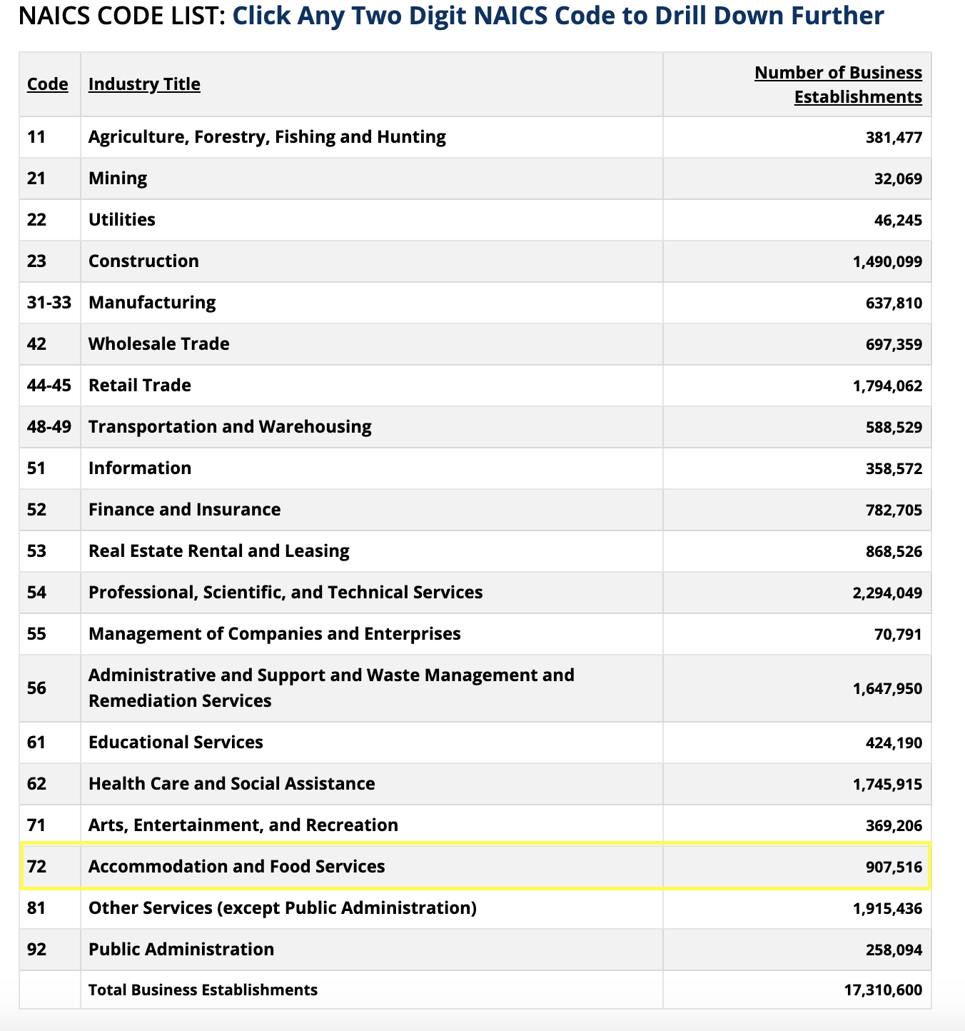

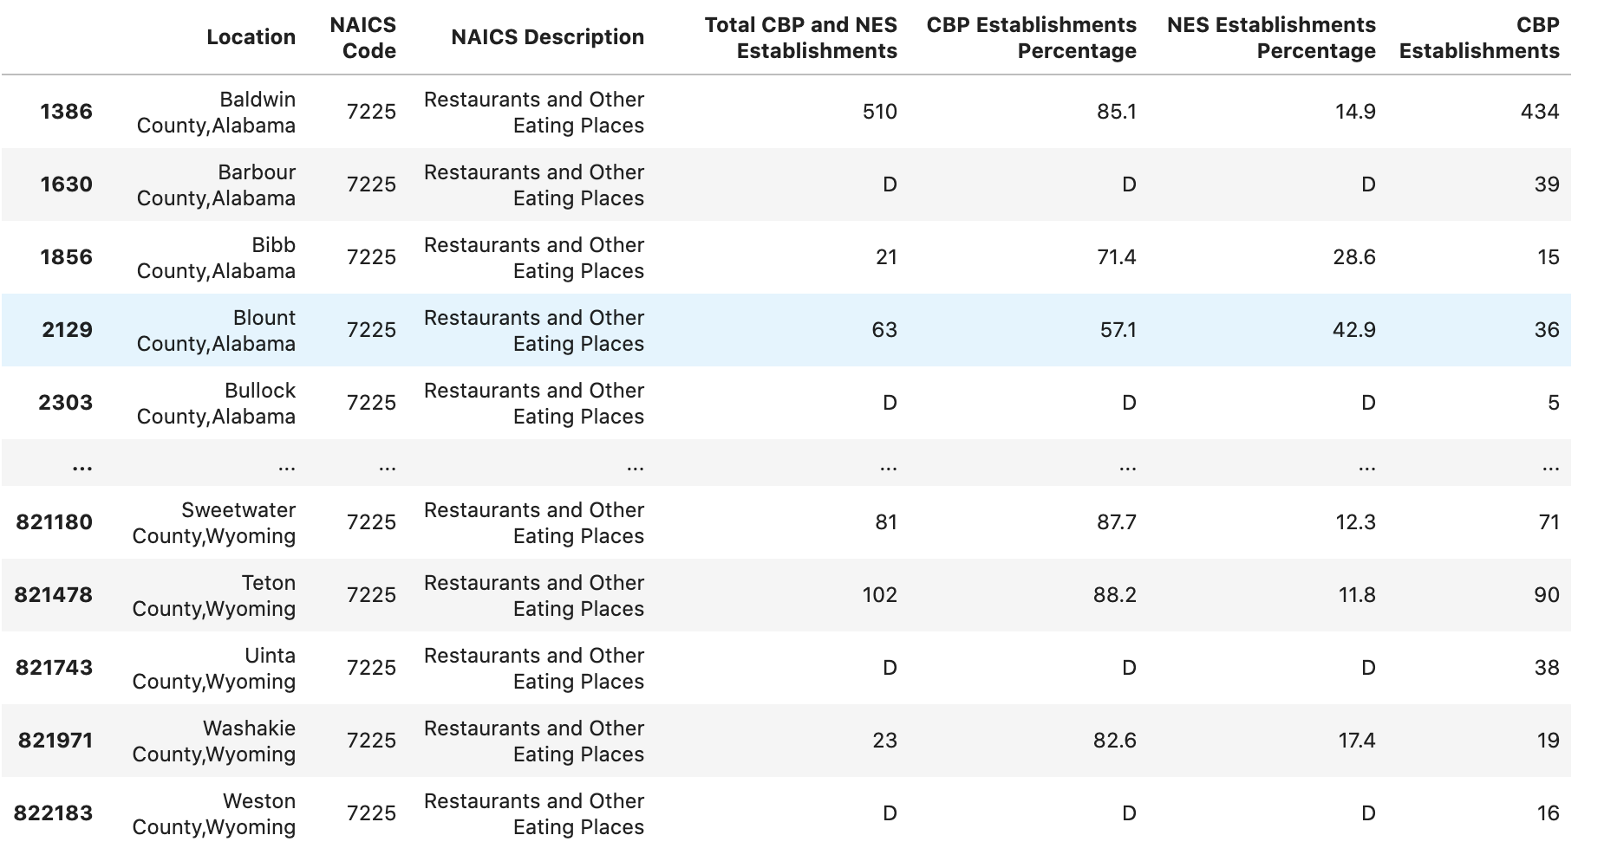
Number of Restaurants

Slide 12
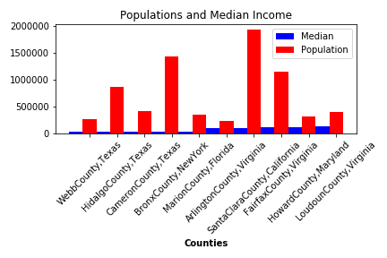
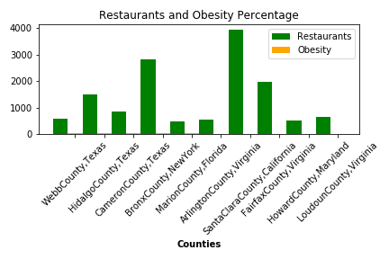
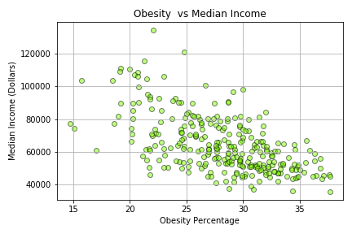
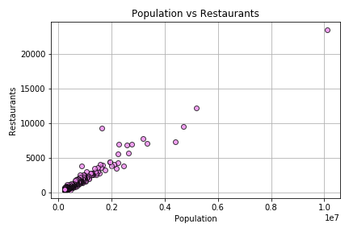
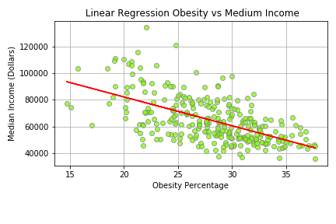
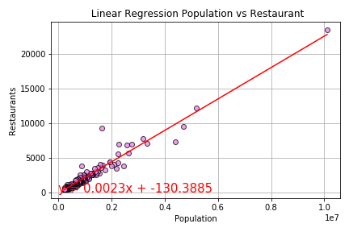
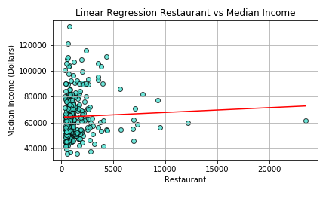
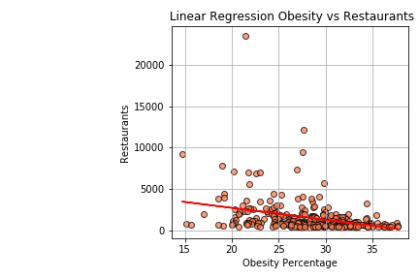
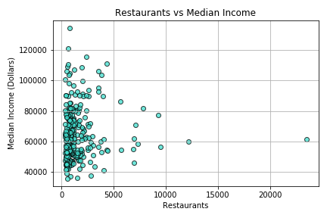
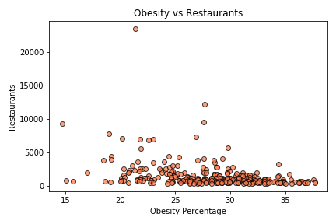

Slide 13
Post Mortem
Discuss any difficulties that arose, and how you dealt with them
Discuss any additional questions that came up, but which you didn't have time to answer: What would you research next, if you had two more weeks?

Slide 14
Questions
Open-floor Q&A with the audience

